Slide 1

WIPRO NGA Program – DWS
Capstone Project Presentation – 4th Sept. 2025
Title:
Add a Launch Condition Restrict installation to certain OS versions or hardware
Presented by -
34851-Krishna Verma
Email : kv979539g@gmail.com
www.rpsconsulting.in

Slide 2

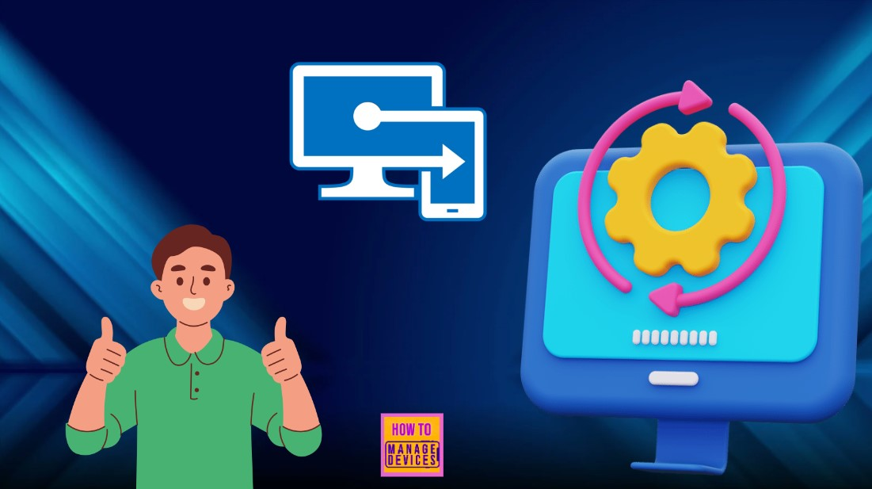

Installations of OS and Hardware Requirements
2
2025 - RPS Consulting all rights reserved

Slide 3
INTRODUCTION
Launch conditions are rules set in an installer to ensure that software runs only on supported environments.
By adding conditions such as operating system version or specific hardware requirements, we prevent installation on incompatible systems.
This improves stability, security, and user experience by ensuring the application is deployed only where it can function properly.
3
2025 - RPS Consulting all rights reserved

Slide 4
What is Launch Condition
A launch condition is a rule in an installer that checks your system before installation starts. If your computer doesn’t meet the requirement (like the right Windows version or 64-bit hardware), the installation will stop and show a message.
2025 - RPS Consulting all rights reserved 4

Slide 5
BENEFITS
Avoids Errors – It prevents the installer from running on systems that don’t meet the requirements, reducing installation failures.
Stable Performance – Ensures the software installs only on compatible operating systems and hardware for smooth functioning.
Saves Time – Users and IT teams save time by avoiding unnecessary troubleshooting from failed installations.
Improves Security – Blocks installation on outdated or unsupported systems that may have security risks.
5
2025 - RPS Consulting all rights reserved

Slide 6
Prerequisites
Windows Operating System – Test machines or VMs with different Windows versions (e.g., Win10, Win11).
Virtualization Software – Hyper-V, VirtualBox, or VMware to create test environments.
Installer Authoring Tool – Advanced Installer & Repackager.
Basic Knowledge of MSI/Installer – Understanding how launch conditions work.
Administrator Access – To install and test software in VMs.
2025 - RPS Consulting all rights reserved 6

Slide 7
Minimum System Requirements
CPU: Dual-Core Processor (2 GHz or higher) – Needed for smooth VM operations and installer testing.
RAM: 4 GB or more – Ensures enough memory to run virtualization software and test OS environments.
Storage: At least 40 GB free space – Required for installing virtualization tools, ISOs, and test files.
Display: 1366×768 resolution or higher – Provides clear visibility for UI-based installer testing.
Operating System: Windows 10 or later – Needed to install WiX Toolset and create launch conditions.
2025 - RPS Consulting all rights reserved 7

Slide 8

FLOWCHART
1. START WITH FRESH INSTALLER IN ADVANCED REPACKAGER IN A CLEAN VM
2. UNPACK THE INSTALLER AND MOVE TO ADVANCED INSTALLER FOR MODIFICATION. SNAPSHOT OF THE VM WILL BE TAKEN.
PROCESS 1
PROCESS 2
5. INSTALL ON THE TEST VM AND COLLECT LOGS GIVE IT AN IMAGE FORM
3. ADD LAUNCH CONDITION TO THE INSTALLER AND MODIFY IT.
PROCESS 3
PROCESS 4
4. BUILD THE NEW INSTALLER
PROCESS 5
2025 - RPS Consulting all rights reserved 8

Slide 9
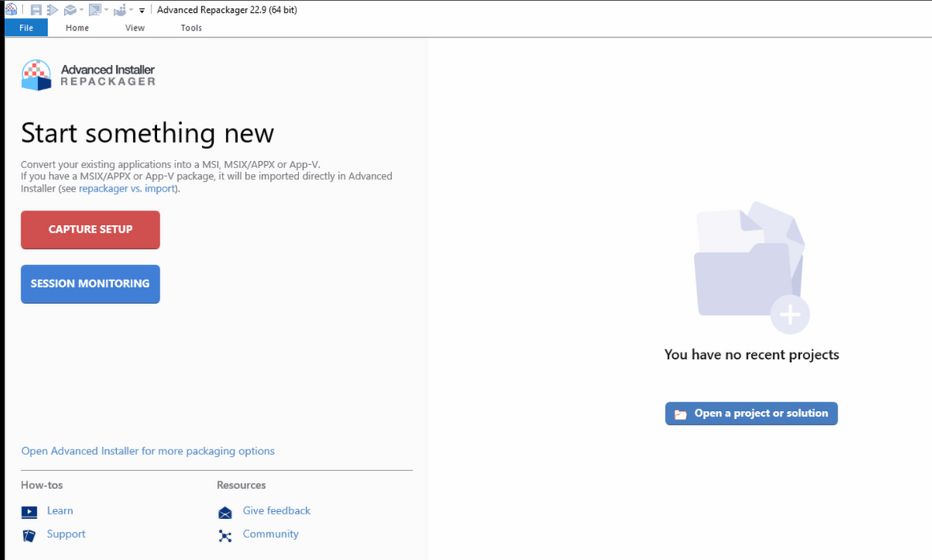
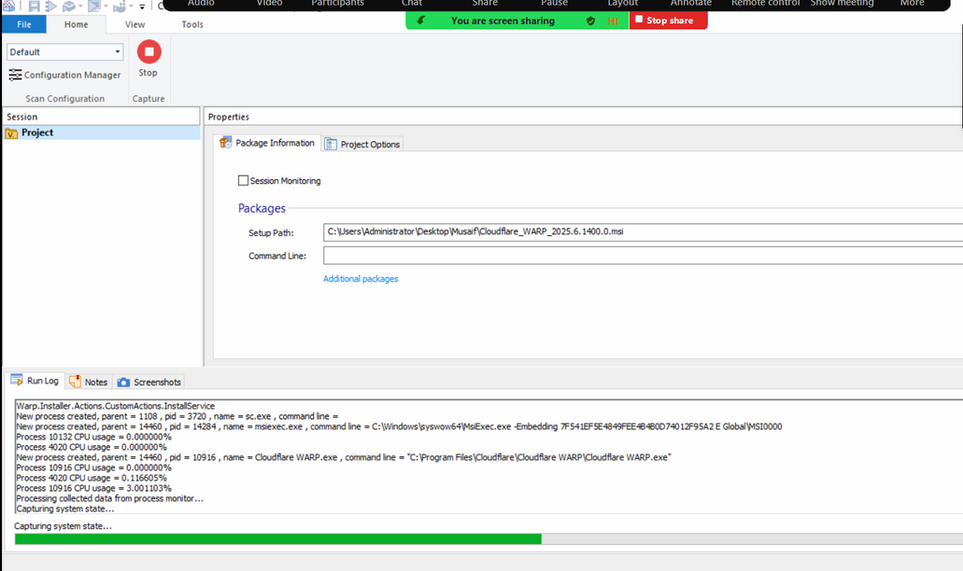
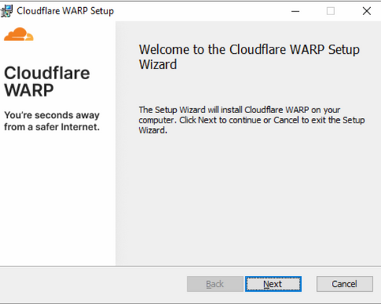
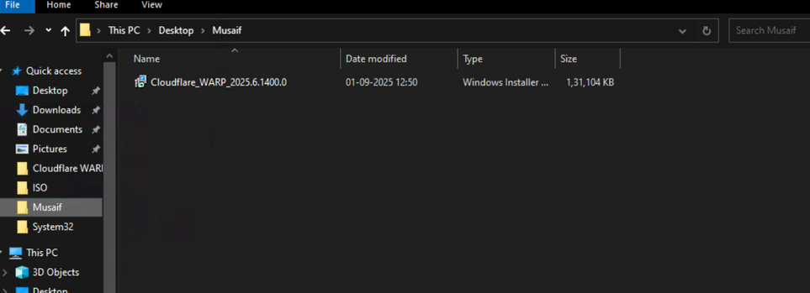
STEPS
Step 4: Click on "Start Local" to begin the capture process and save the MSI file.
Step 5: Uninstall the application you're repackaging if it's already installed on your system.
.
Step 6: Another pop-up to install the MSI will appear. Click "Next" and then "Install."
Step 1: Create a folder to save your repackaged MSI file.
Step 2: Open the application repackaging tool.
Step 3: Click on "Capture Setup." Select the MSI file you want to repackage and provide a name for the output.
2025 - RPS Consulting all rights reserved 9

Slide 10
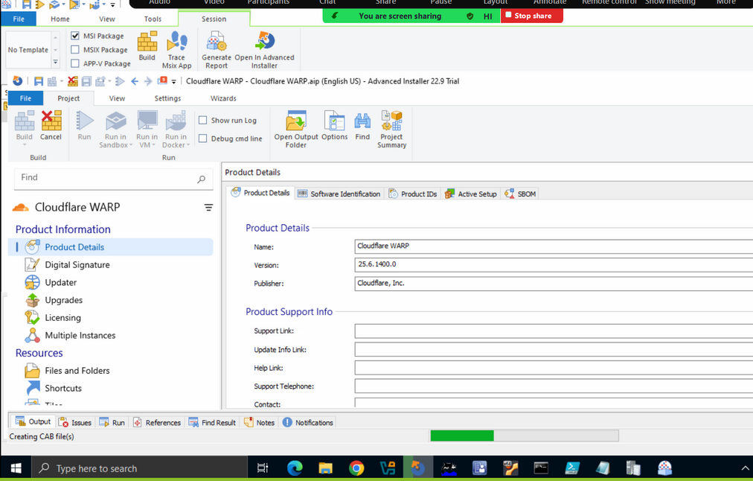
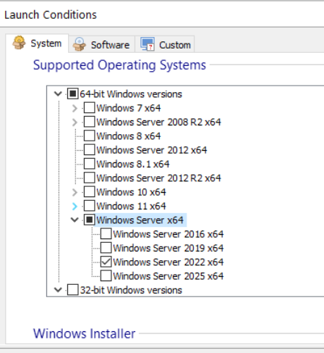
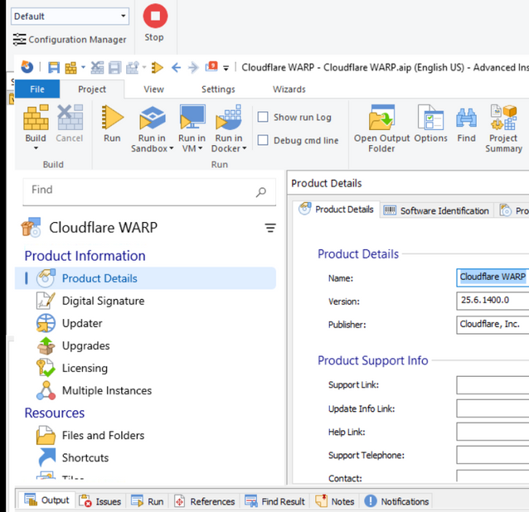
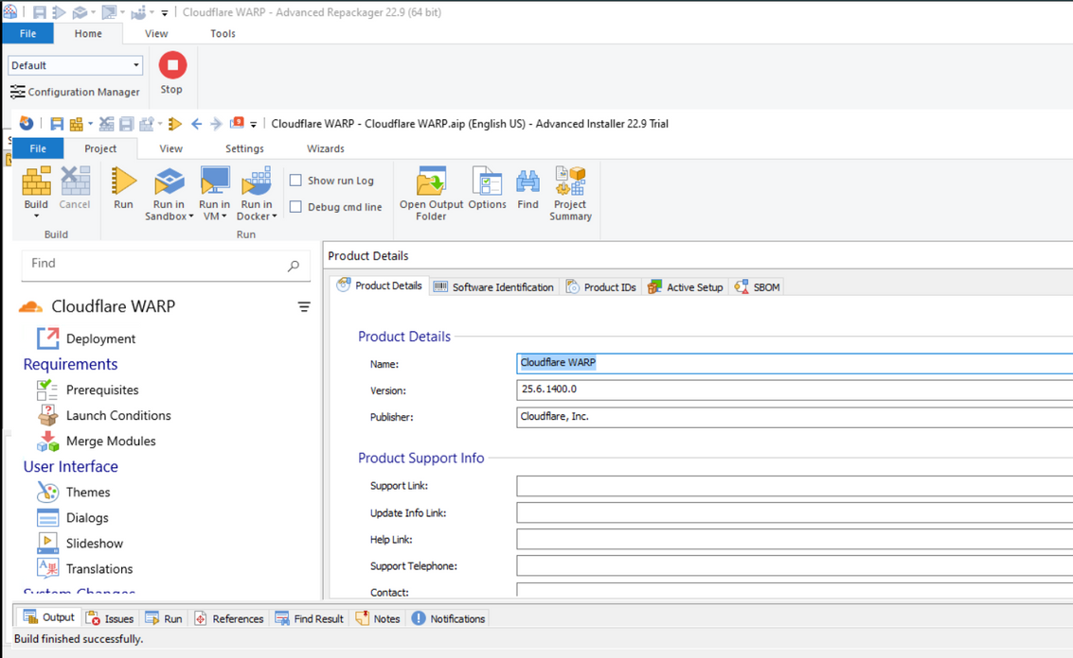
STEPS
Step 7:After the installation is done, open the package in Advanced Installer.
Scroll down to and click "Launch Conditions."
Step 8: Under the System Software category, unselect the default "Any Windows Version" option.
Step :9 Select the specific OS versions you want to allow, such as Windows Server 2022 x64 and Windows Server x64.
Step :10 Select the specific OS versions you want to allow, such as Windows Server 2022 x64 and Windows Server x64.
Step 11: Go to "Product Details" and then click "Build."
Step 12: A pop-up will appear. Click "Continue."
Step 13: Save the final MSI file in your folder.
2025 - RPS Consulting all rights reserved 10

Slide 11
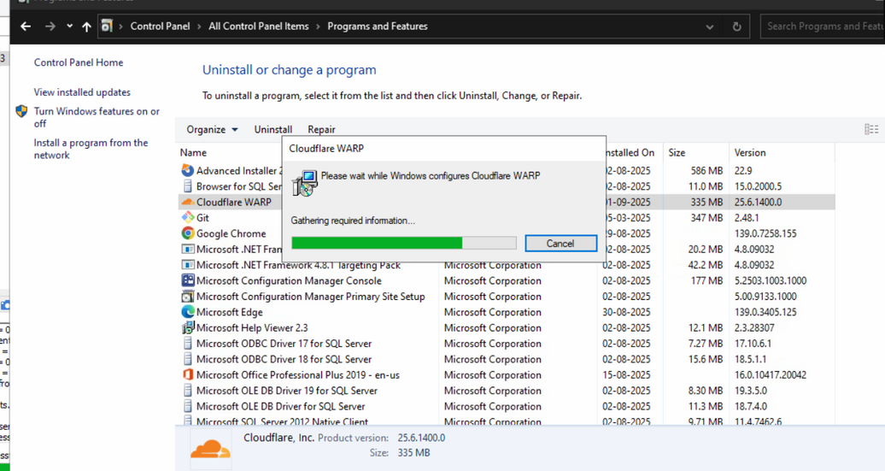
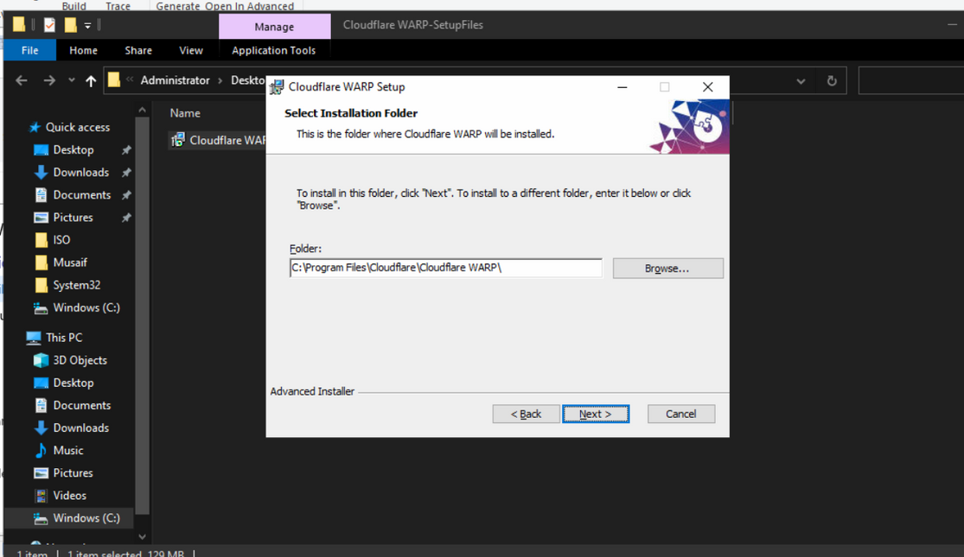
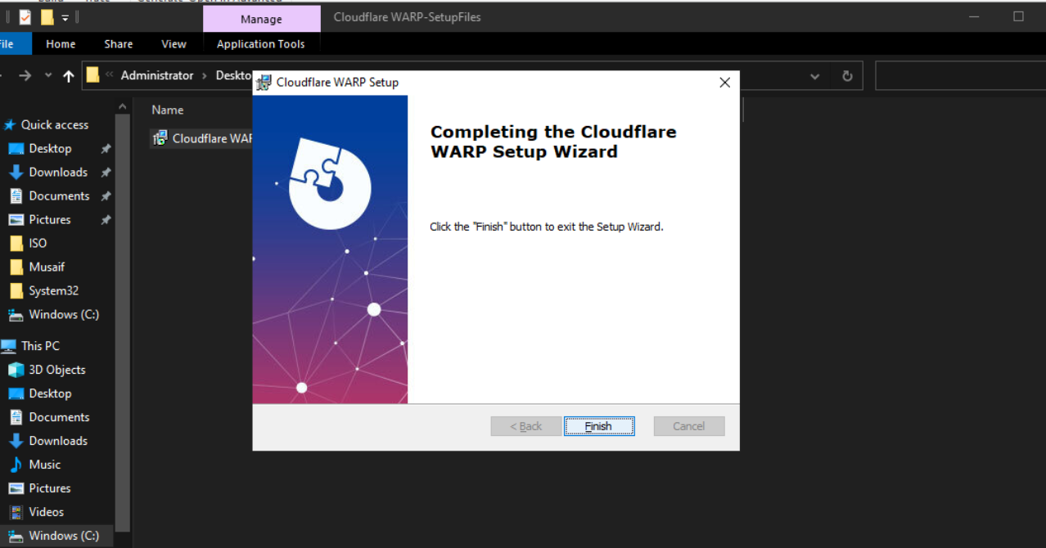
RESULT
Step :14 Go to Control Panel and uninstall the MSI file you just built.
Step :15 Navigate to the output folder and double-click the newly built MSI file.
Step :16 Installation Pop-up" will appear. Click "Next" and "Install" until it's done, then click "Finish.
2025 - RPS Consulting all rights reserved 11

Slide 12
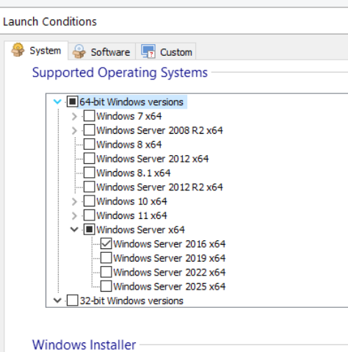
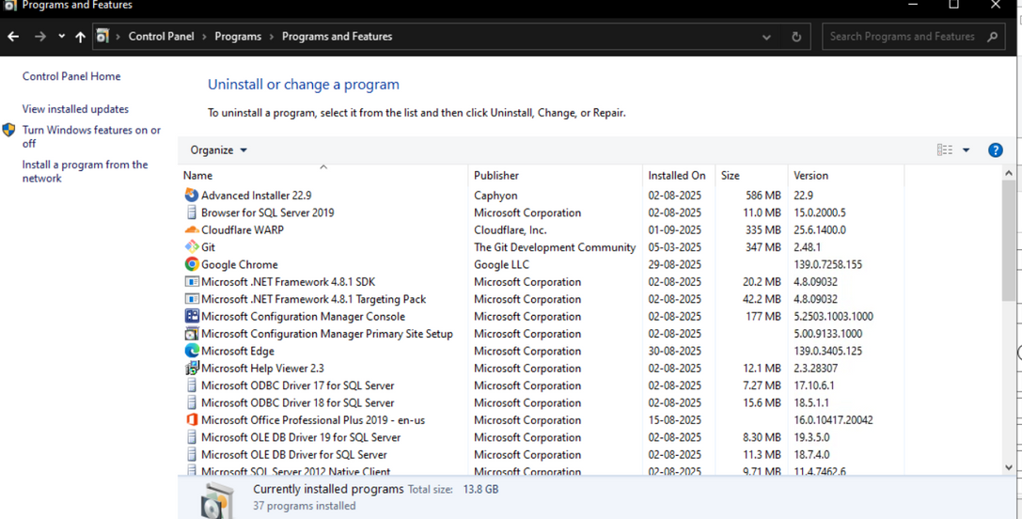
RESULT
Step: 18To test the launch condition, go to the "Launch Conditions" section again.
Step 19: Select a random Windows version that is not on your current system.
Step :20 Go to "Product details" and then "Build."
Step :21 Click "Continue" when the pop-up appears.
Step :17 Check the "Control Panel" to confirm that the software is installed.
2025 - RPS Consulting all rights reserved 12

Slide 13
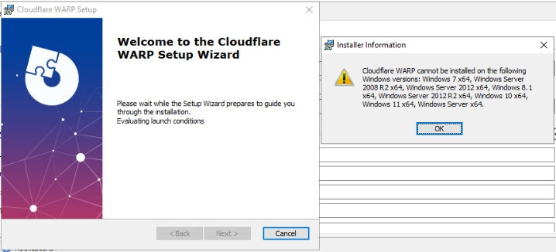
RESULT
Step-22:
Click on the MSI file you built again.
If that fails to install, that means our launch condition were successful.
2025 - RPS Consulting all rights reserved 13

Slide 14

CONCLUSION
After completing this project, we successfully implemented a launch condition that restricts software installation based on specific OS versions or hardware. This ensures compatibility, prevents installation on unsupported systems, and improves overall deployment reliability.
2025 - RPS Consulting all rights reserved 15

Slide 15

Sources and references
https://www.advancedinstaller.com/user-guide/
https://learn.microsoft.com/en-us/windows/win32/msi/launch-conditions
2025 - RPS Consulting all rights reserved 16

Slide 16
THANK YOU
www.rpsconsulting.in

